Slide 1

Eigenvalue Problem
prepared by Razana Alwee
Notes:
prepared by Razana Alwee

Slide 2
Eigenvalues
Let A be a square matrix of dimension nxn and let v be a vector of dimension n.
The product,
Y=Av
can be viewed as a linear transformation from n-dimensional into itself.
prepared by Razana Alwee

Slide 3
Eigenvalues
We want to find scalars λ for which there exists a nonzero vector v such that
Av = λv
that is, the linear transformation T(v) = Av maps v onto the multiple λv.
When this occurs, we call v an eigenvector that corresponds to the eigenvalue λ, and together they form the eigenpair λ, v for A.
prepared by Razana Alwee

Slide 4
Eigenvalues
The identity matrix I can be used to express equation
Av = λv
as
Av = λIv
which is then rewritten in the standard form for a linear system as,
(A − λI) v = 0
prepared by Razana Alwee

Slide 5
Eigenvalues
This linear system,
(A − λI) v = 0
has nontrivial solutions if and only if the matrix A − λI
is singular, that is
det (A − λI) =0
When the determinant is expanded, it becomes a polynomial of degree n, which is called the characteristic polynomial,
p(λ)=det (A − λI)
prepared by Razana Alwee

Slide 6
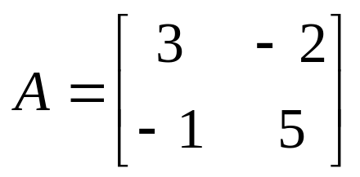
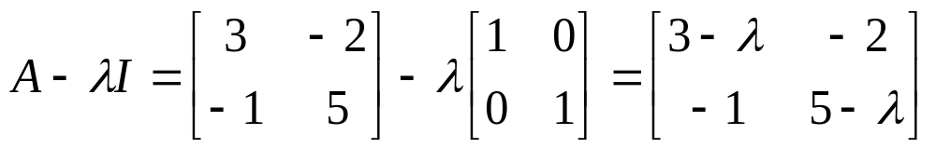
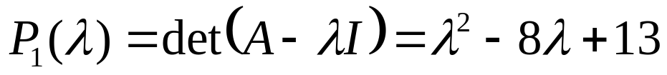
Example
Let
The characteristic polynomial of the matrix A
prepared by Razana Alwee

Slide 7
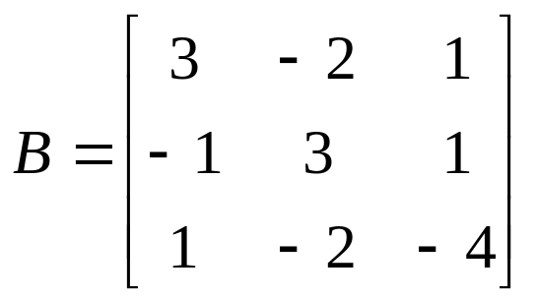
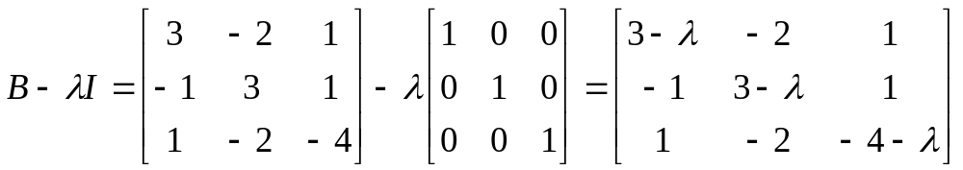
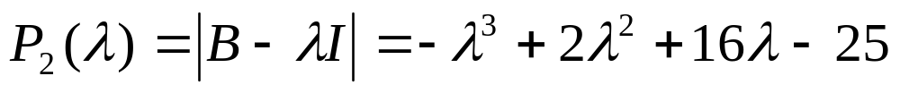
Example
Let,
The characteristic polynomial of the matrix B
prepared by Razana Alwee

Slide 8
Eigenvalue & Eigenvector
If A is an nxn matrix, then its n eigenvalues λ₁, λ₂,…, λ_{n} are the roots of the characteristic polynomial
p(λ)=det (A − λI)
If λ is an eigenvalue of A and the nonzero vector v has the property that
Av = λv
then v is called an eigenvector of A corresponding to the eigenvalue λ.
prepared by Razana Alwee

Slide 9
Eigenvalues
To find eigenvalues when the dimension n is small
  Find the coefficient of the characteristic polynomial
  Finds its root
  Find the nonzero solutions of the homogeneous linear system (A − λI) v = 0
Finding the determinant of an nxn matrix is computationally expensive and finding good approximations to the roots of p(λ) is also difficult.
prepared by Razana Alwee

Slide 10

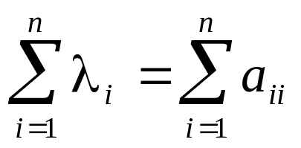
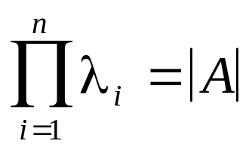
Theorem
Assume that A is nxn matrix and let
are eigenvalues of A
prepared by Razana Alwee

Slide 11
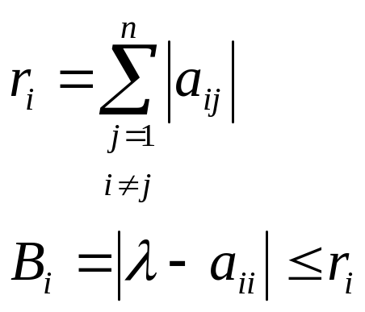
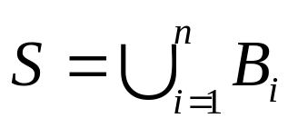
Gerschgorin’s Circle Theorem
Assume that A is nxn matrix, and let B_{i} denote the disk in the complex plane with center a_{ii} and radius r_{i}
If
then all the eigenvalues of A lie in the set S.
prepared by Razana Alwee

Slide 12
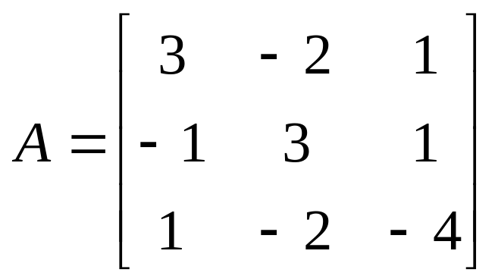
Example
Let
prepared by Razana Alwee

Slide 13
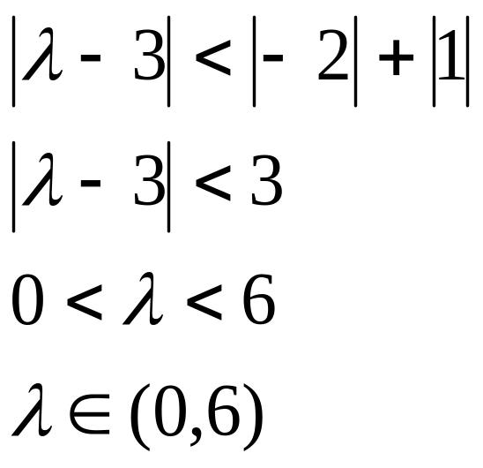
Example
center
Row 1
radius
prepared by Razana Alwee

Slide 14
Example
Circle
radius, 3
0
3
6
center
prepared by Razana Alwee

Slide 15
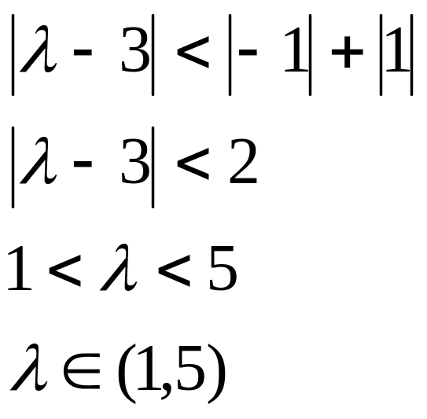
Example
center
Row 2
radius
prepared by Razana Alwee

Slide 16
Example
Circle
radius, 2
0
1
3
5
center
prepared by Razana Alwee

Slide 17
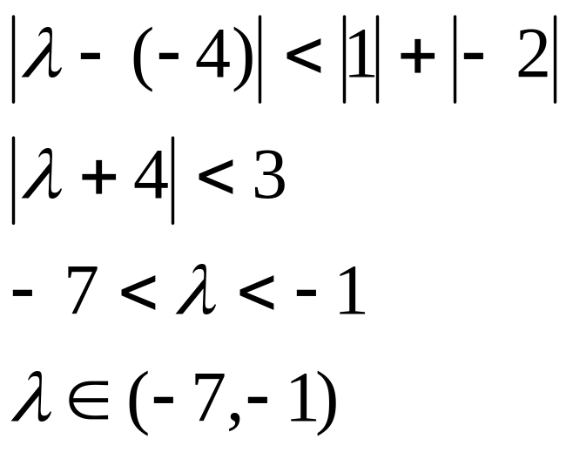
Example
center
Row 3
radius
prepared by Razana Alwee

Slide 18
Example
Circle
radius, 3
0
-7
-1
-4
center
prepared by Razana Alwee

Slide 19
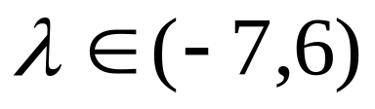
Example
-7
-1
0
1
5
6
prepared by Razana Alwee

Slide 20
Power Method
The power method is an iterative technique used to determine the dominant eigenvalue of a matrix – that is, the eigenvalue with the largest magnitude.
By modifying the method slightly, it can also be used to determine other eigenvalues.
One useful feature of the power method is that it produces not only an eigenvalue, but also as associated eigenvector.
prepared by Razana Alwee

Slide 21
Power Method
If λ₁ is an eigenvalue of A that is larger in absolute value than any other eigenvalue, it is called the dominant eigenvalue.
An eigenvector v₁ corresponding to λ₁ is called a dominant eigenvector.
prepared by Razana Alwee

Slide 22
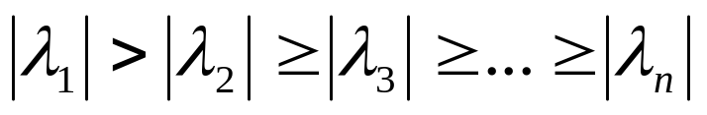
Power Method
To apply the power method, we assume that the nxn matrix A has n eigenvalues λ₁, λ₂,…, λ_{n} with an associated collection of linearly independent eigenvectors {v⁽¹⁾, v⁽²⁾,.. v^{(n)}}
We assume that A has precisely one eigenvalue, λ₁ that is largest in magnitude, so that
prepared by Razana Alwee

Slide 23

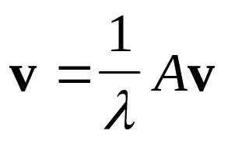
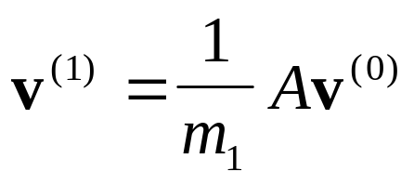
Power Method
Start with vector, v⁽⁰⁾
prepared by Razana Alwee

Slide 24
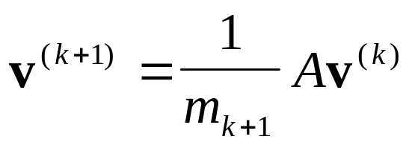

Power Method
Generate the sequence {v^{(k)}} recursively, using
Where m_{k+1} is the coordinate of Av^{(k)} of largest magnitude (in the case of a tie, choose the coordinate that comes first).
prepared by Razana Alwee

Slide 25
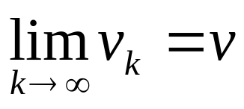
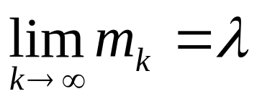
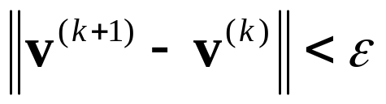
Power Method
The sequences {v^{(k)}} and {m_{k}} will converge to v and λ, respectively.
Termination criteria: Select a tolerance (error), ε>0 and generate v₁,….,v_{k+1} until
prepared by Razana Alwee

Slide 26
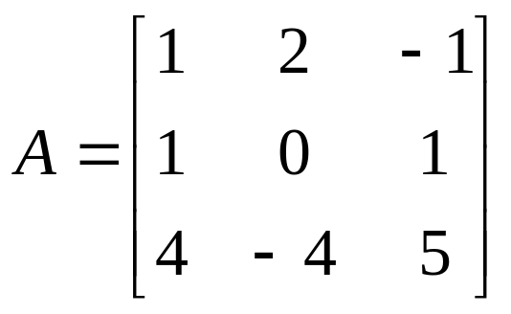
Example
Let
Use the Power method to approximate the most dominant eigenvalue of the matrix. Let v⁽⁰⁾=(0,0,1)^{T} and iterate until ε=0.001.
prepared by Razana Alwee

Slide 27
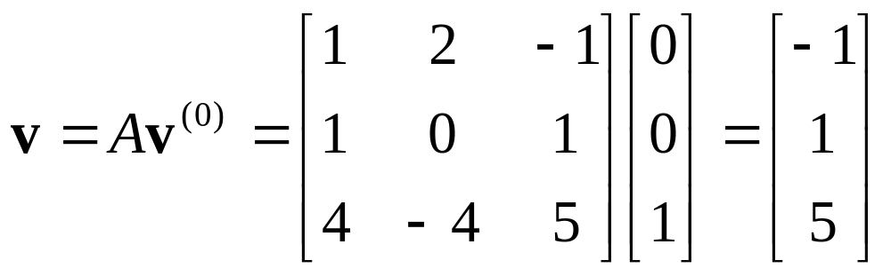

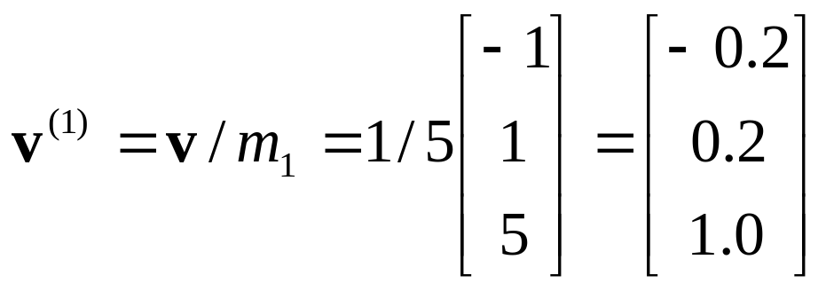
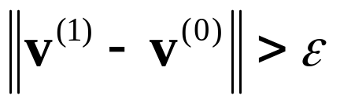
Example
(largest magnitude)
(next iteration)
prepared by Razana Alwee

Slide 28
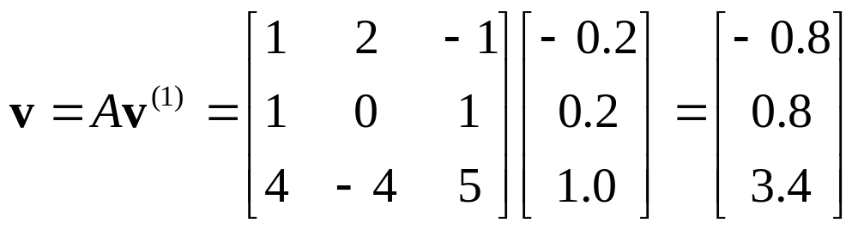

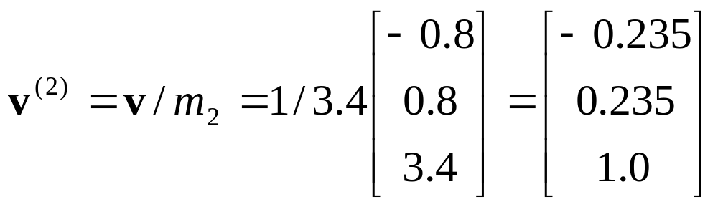
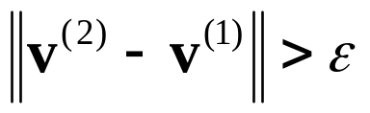
Example
(next iteration)
prepared by Razana Alwee

Slide 29
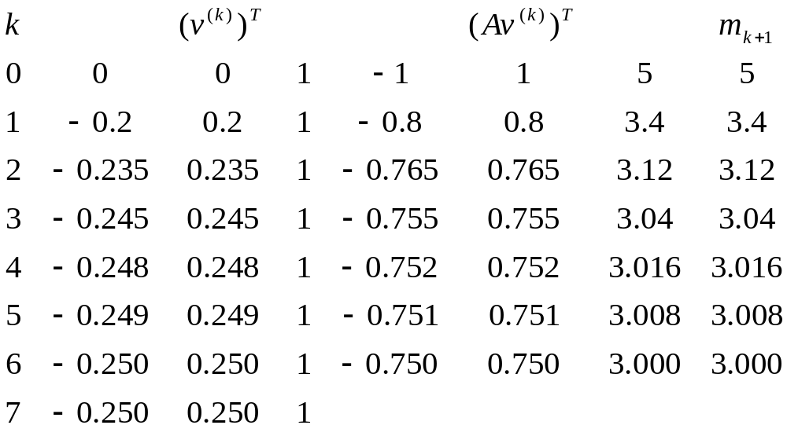
Example
prepared by Razana Alwee

Slide 30
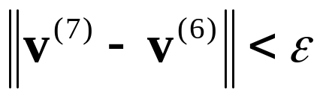
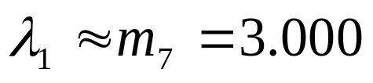
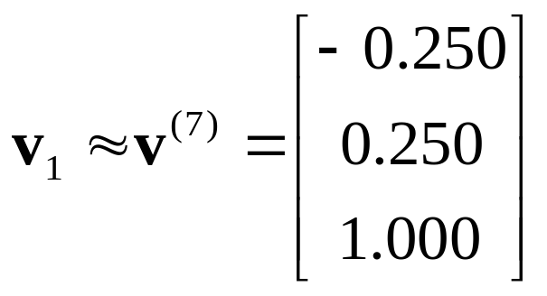
Example
prepared by Razana Alwee

Slide 31
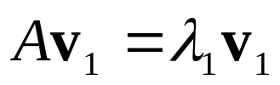
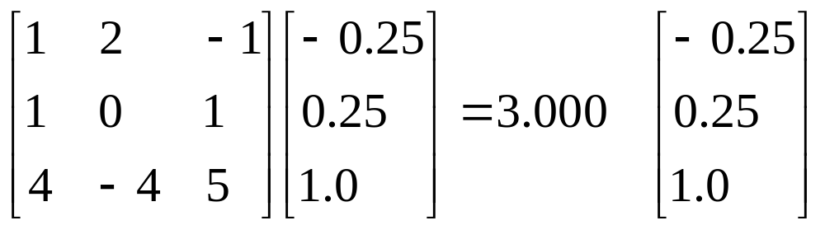
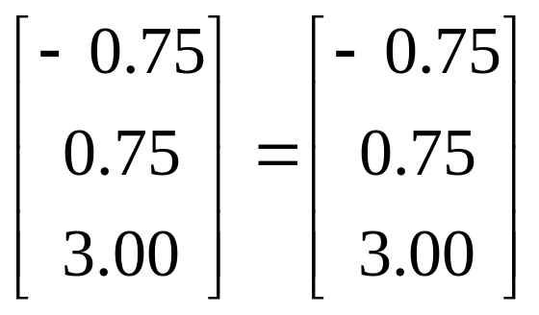
Example
√
prepared by Razana Alwee

Slide 32
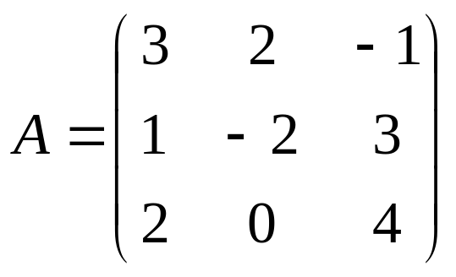
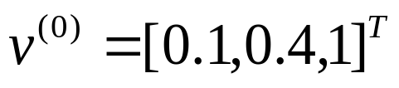
Exercise
Let
Use the Gerschgorin’s Circle Theorem to determine a region containing all the eigenvalues of A.
Use the Power method to determine the dominant eigenvalue of the matrix and its associated eigenvector. Iterate until ε=0.005.
prepared by Razana Alwee

Slide 33
The Shifted Power Method
Consider the standard eigenvalue problem Av=λv
By subtracting a scalar s from both sides of the standard eigenvalue problem, the eigenvalues of the matrix are shifted:
Av – sIv =λv − sv
which yields
(A – sI) v = (λ– s)v
and can be written as
A_{shifted}v = λ_{shifted}v
prepared by Razana Alwee

Slide 34
The Shifted Power Method
A_{shifted} is the shifted matrix,
A_{shifted} = (A – sI)
λ_{shifted} = λ − s is the eigenvalue of the shifted matrix.
Shifting matrix A by a scalar s shifts the eigenvalue by s.
Shifting a matrix by a scalar does not affect the eigenvectors.
prepared by Razana Alwee

Slide 35
The Shifted Power Method
Shifting of eigenvalues of a matrix can be used to find the opposite extreme eigenvalue, which is either
  the smallest magnitude eigenvalue, or
  the largest magnitude eigenvalue of opposite sign
prepared by Razana Alwee

Slide 36
Opposite Extreme Eigenvalue
Consider a matrix whose eigenvalues are all the same sign; λ=1, 2, 4, and 8.
λ=8 is the eigenvalue of largest magnitude.
λ=1 is the opposite extreme eigenvalue.
The eigenvalue of largest magnitude λ₁=8 can be found by the power method.
Shifting the eigenvalues by s=8, yields the shifted eigenvalues λ = -7, -6, -4, 0.
prepared by Razana Alwee

Slide 37
Opposite Extreme Eigenvalue
The largest magnitude eigenvalue of the shifted matrix can be found by the power method; λ_{shifted, largest} = -7.
The smallest eigenvalue of the original matrix may be found by
λ_{smallest} = λ_{shifted, largest} + 8 = -7+ 8 =1
prepared by Razana Alwee

Slide 38
The Shifted Power Method
Consider a matrix whose eigenvalues are both positive and negative; λ=-1, -2, 4, and 8.
λ=8 is the eigenvalue of largest magnitude.
λ=-2 is the opposite extreme eigenvalue.
The eigenvalue of largest magnitude λ₁=8 can be found by the power method.
Shifting the eigenvalues by s=8, yields the shifted eigenvalues λ = -9, -10, -4, 0.
prepared by Razana Alwee

Slide 39
The Shifted Power Method
The largest magnitude eigenvalue of the shifted matrix can be found by the power method; λ_{shifted, largest} = -10.
The largest magnitude eigenvalue of opposite sign of the original matrix may be found by
λ_{largest,negative} = λ_{shifted, largest} + 8 = -10+ 8 = -2
prepared by Razana Alwee

Slide 40
The Shifted Power Method
The shifted power method can be summarized as follows:
  Solve for the eigenvalue of largest magnitude λ₁ using the power method.
  Shift the matrix A by s=λ₁ to obtain the shifted matrix A_{shifted}.
  Solve for the eigenvalue λ_{shifted} by the power method.
  Compute the opposite extreme eigenvalue of matrix A by
  λ= λ_{shifted} + s
prepared by Razana Alwee

Slide 41
Example
Let,
The dominant eigenvalue of A is λ₁=3.0.
Use the shifted power method to find the remaining eigenvalues of A.
prepared by Razana Alwee

Slide 42
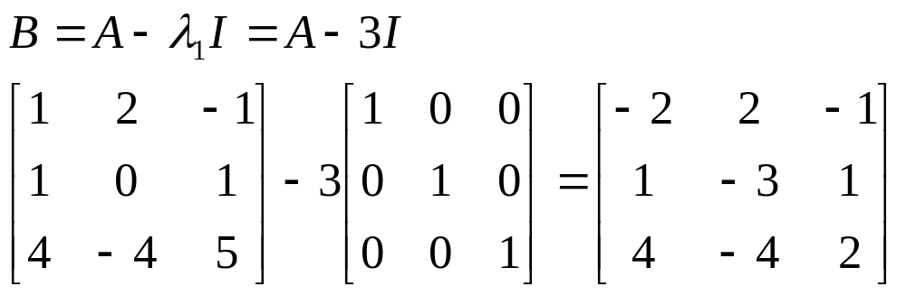
Example
Let B = A_{shifted}
prepared by Razana Alwee

Slide 43
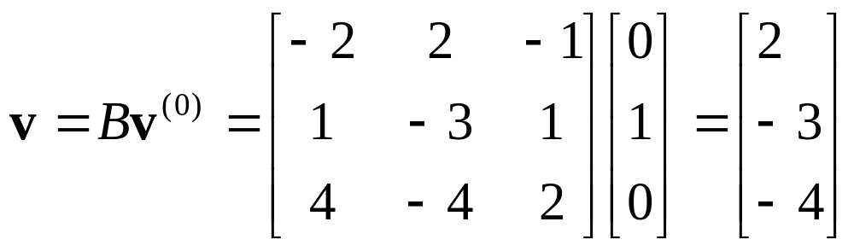
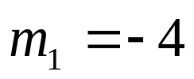
Example
Let, v ⁽⁰⁾ =[0, 1, 0]^{T} and ε=0.001
prepared by Razana Alwee

Slide 44
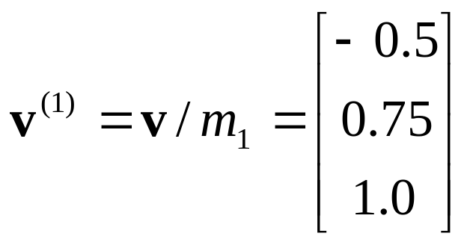
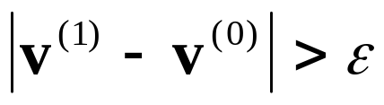
Example
(next iteration)
prepared by Razana Alwee

Slide 45
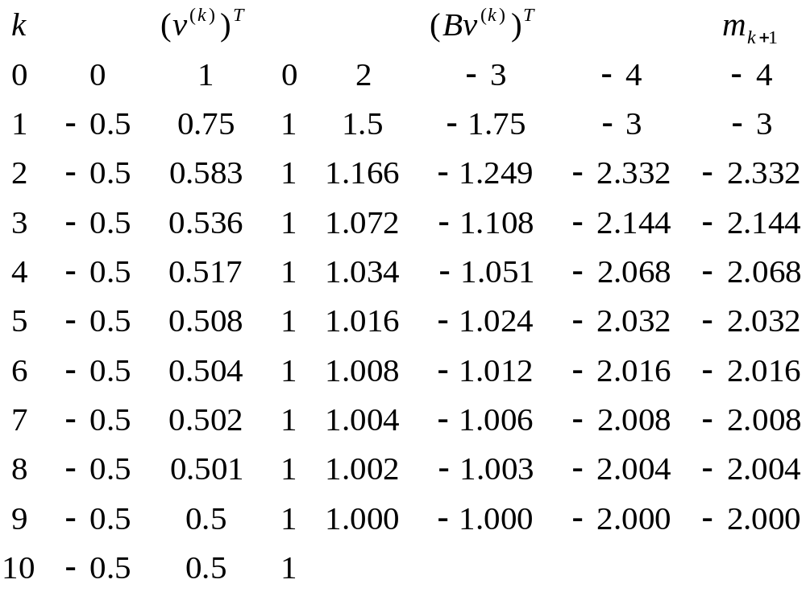
Example
prepared by Razana Alwee

Slide 46

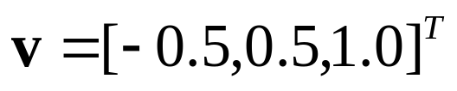
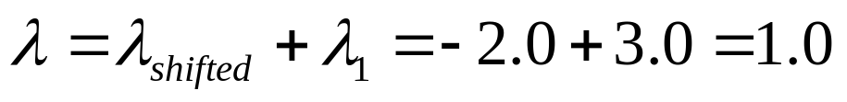
Example
The largest magnitude eigenvalue of the shifted matrix and its eigenvector,
The opposite extreme eigenvalue of matrix A and its eigenvector,
prepared by Razana Alwee

Slide 47

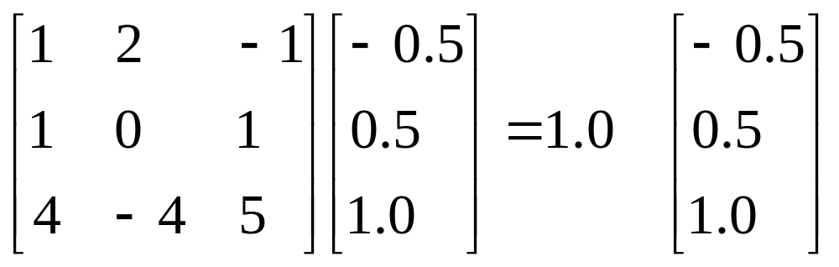
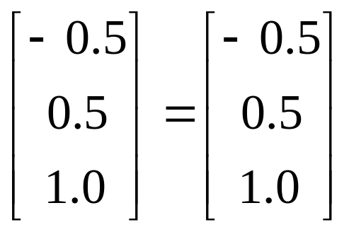
Example
√
prepared by Razana Alwee

Slide 48
Example
Since the opposite extreme eigenvalue λ=1, has the same sign as the largest magnitude eigenvalue of the original matrix λ₁=3, all eigenvalues of A are positive and λ=1 is the smallest eigenvalue of matrix A.
prepared by Razana Alwee

Slide 49
Example
Matrix A has 3 eigenvalues, λ₁,λ₂, and λ₃.
Let,
|λ₁| ≥ |λ₂| ≥ |λ₃|
The largest eigenvalue of matrix A, λ₁=3
The smallest eigenvalue of matrix A, λ₃=1
prepared by Razana Alwee

Slide 50
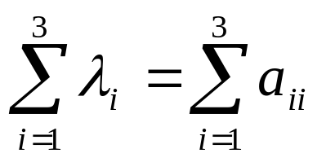
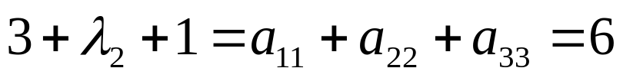

Example
Find the intermediate eigenvalue of matrix A, λ₂
prepared by Razana Alwee

Slide 51

Exercise
Let,
The dominant eigenvalue of D is λ₁=3.0.
Use the shifted power method to find the remaining eigenvalues of D.
Let v ⁽⁰⁾ =[1, 0.5, 0]^{T} and iterate until ε=0.01.
prepared by Razana Alwee

